Slide 1
Group 8
Project Presentation
by:
Lukas Stuber
Leonardo Avoni
Alexander Stephan

Slide 2
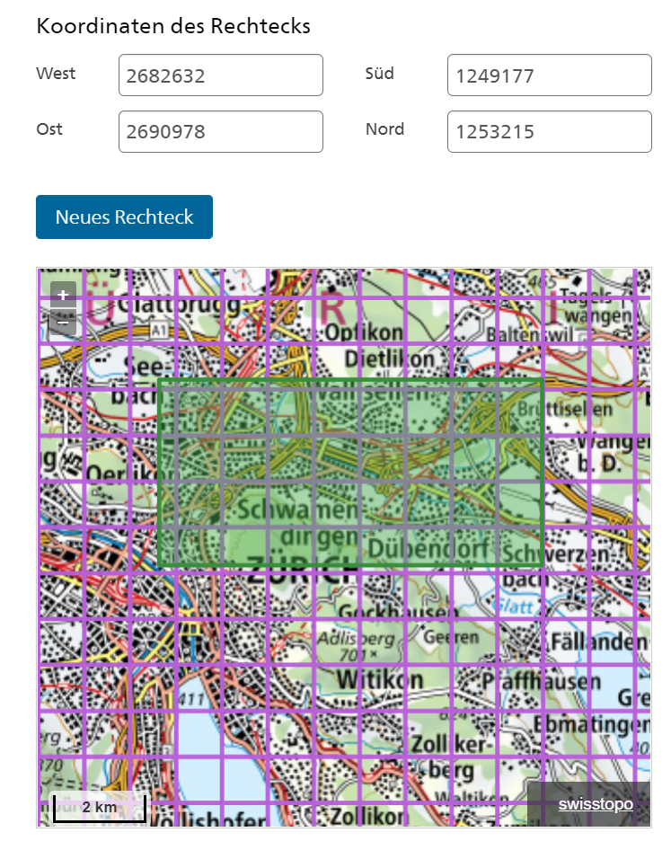
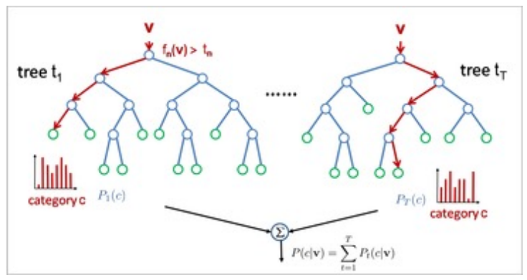
Road traffic recognition and analysis
Introduction and Motivation
Goal: Automatically identify cars in images
Data: 45 images from Swisstopo, Zurich agglomeration, 5 x 9 km2 (aerial images, 0.1m resolution RGB, free)
Current progress: identified GT
Methodology
Once the GT are obtained (at least 3 km2):
Segment each image
Identify features
Implement random forest
Optimize parameters of the RF
Iterate after evaluating the accuracy of the classifier
Use the producer accuracy for cars

Slide 3
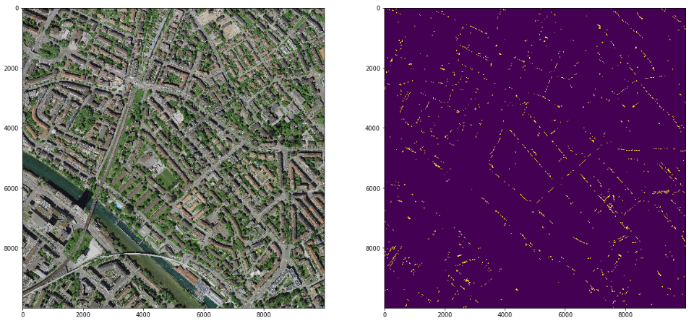
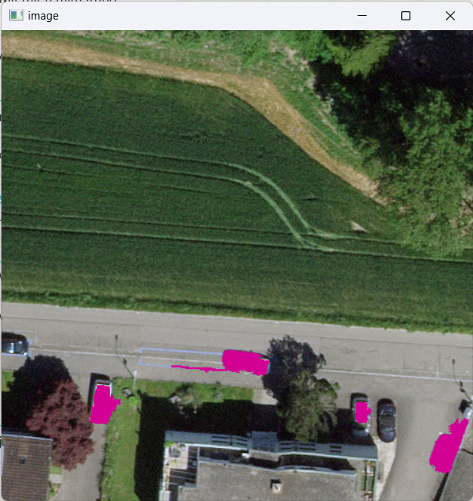
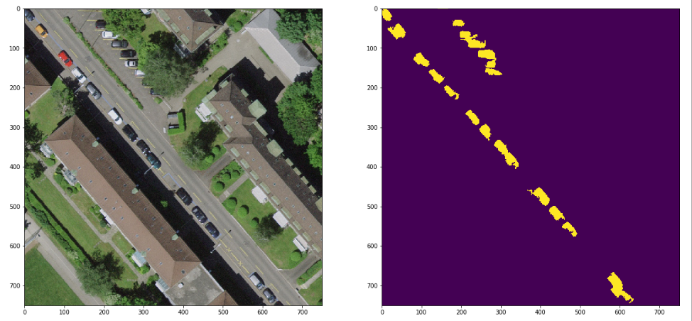
First Results
Manually created GT image
Created Python script to generate the GT (fast user interface
Binary ground truth images:
500 - 800 cars / km2 (depending on population density)

Slide 4
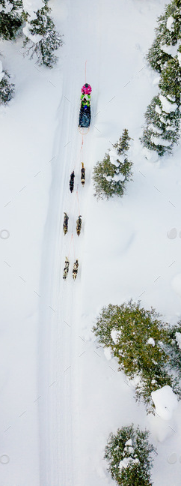
Challenges and Limitations
Challenge: Choice of SLIC region size to only select cars and not surroundings (Too small regions lead to unfeasible high annotation effort)
TBD: Choice of image features for RF
Light conditions can be very bad (shadows, trees)
Sometimes two car regions touch (two small cars, or one big car?)
Do we have enough labelled cars ???
How do we treat sleds pulled by reindeer?
24%🎅

